Slide 1


Welcome, Player
Ludwik Bacmaga, Arnold Bukachi, Chun lee

Slide 2

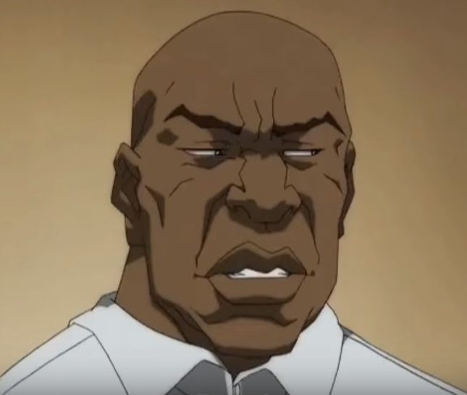

The Team
Ludwik Bacmaga, Modelling + Programming
Arnold Bukachi, Game Design + Management
Chun Lee, Programming

Slide 3
The Project
NINJA! Shine
Augmented Reality Stealth Puzzler
Logo design subject to change. All rights reserved.

Slide 4
The Research
INSERT 1st point
INSERT 2nd point
INSERT 3rd point

Slide 5
The Research
How physical environment interact with
Augmented Reality

Slide 6
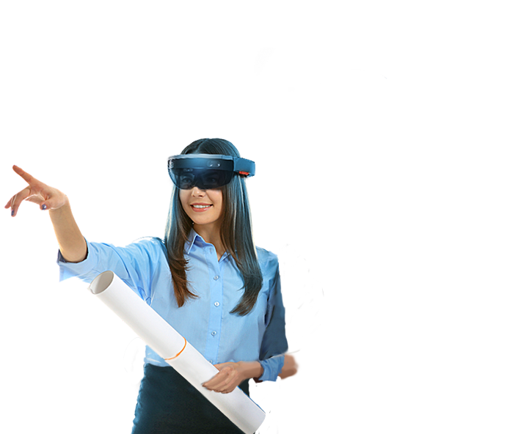
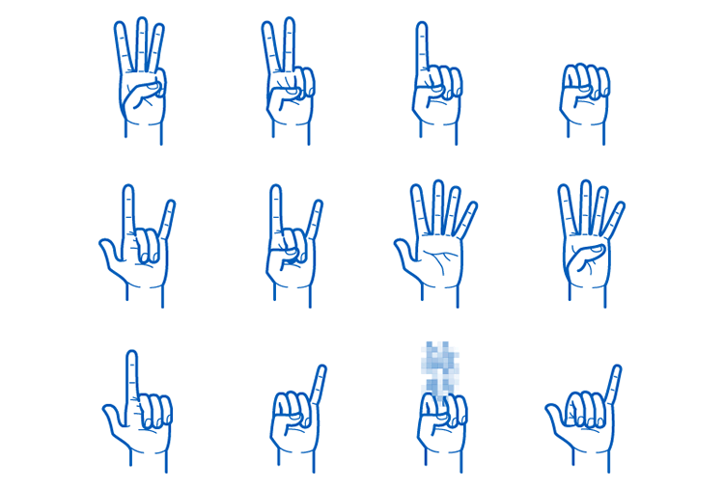

Natural UI

Slide 7
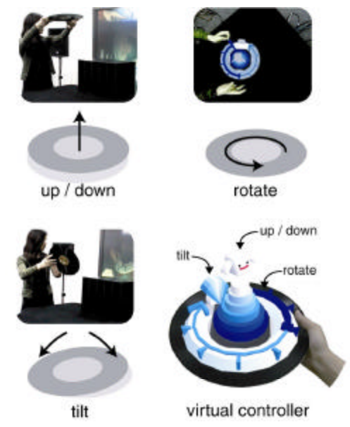
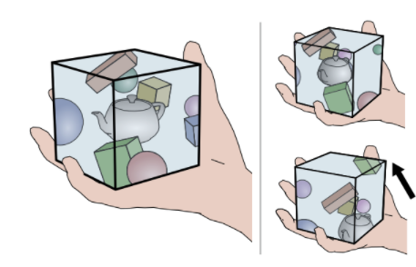
Tangible UI

Slide 8
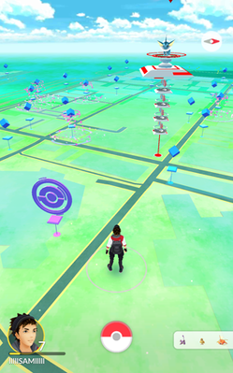
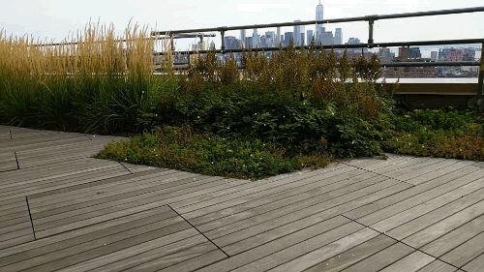
Location-based AR

Slide 9
The Research
Gold mine waiting to be dug
MekaMon
Future add-on to product

Slide 10
Tech Demo
TUI Controller https://www.youtube.com/watch?v=hmV8tUExz6Y
ARKit Boundary drawing and modifying https://www.youtube.com/watch?v=oyDblctAdaw

Slide 11
Thanks!
Dzięki!
Asante!
謝謝!

Slide 12
Shout Outs
https://twitter.com/crowbargordon (Gordon Freeman)
https://youtu.be/srcVg142yCQ (Philbert Stowlove)
http://street-fighter-sprites.wikia.com/wiki/Category:Street_Fighter_II_series_Icons (Chun Li)
http://www.oddcast.com/technologies/voicerecognition/ (Voice Recognition)
https://dribbble.com/shots/1479927-Hand-Gesture-Pack (Hand Gesture Pack by Tom Johnson)
http://www.daenet.de/#/Home (HoloLens)
http://www.csie.nuk.edu.tw/~ayen/teach/ar/ref/Tangible%20Augmented%20Reality.pdf (ARGroove)
https://arxiv.org/pdf/1603.02642.pdf (Tangible Volume)
https://en.wikipedia.org/wiki/File:Pok%C3%A9mon_Go_-_screenshot_of_map.png (Pokemon Go)
https://experiments.withgoogle.com/ar/hidden-world (Hidden World)

